Slide 1
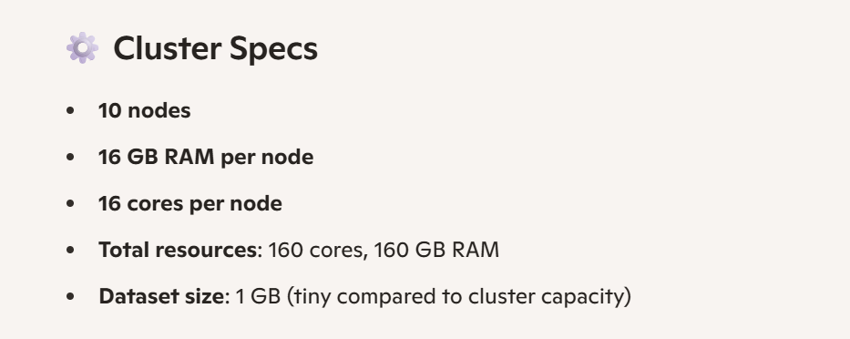


Slide 2
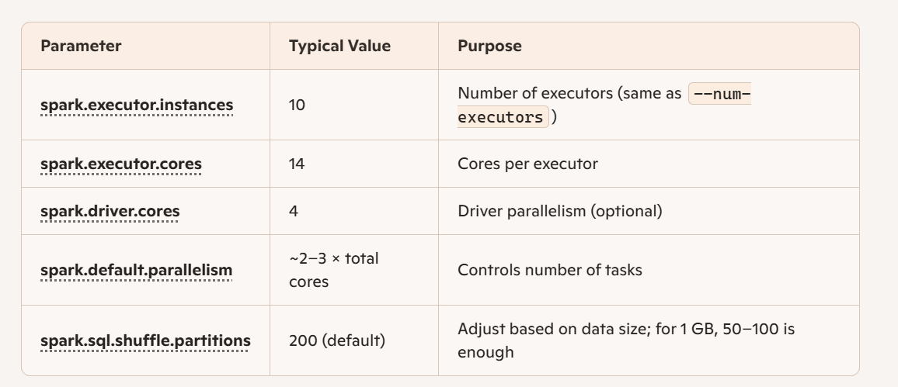

Slide 3
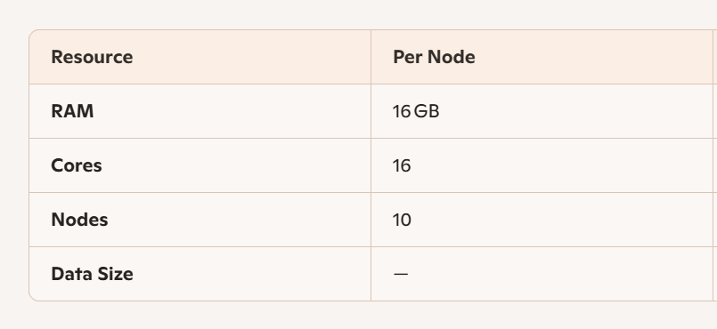
CALCULATE
Lets assume data size is t TB

Slide 4
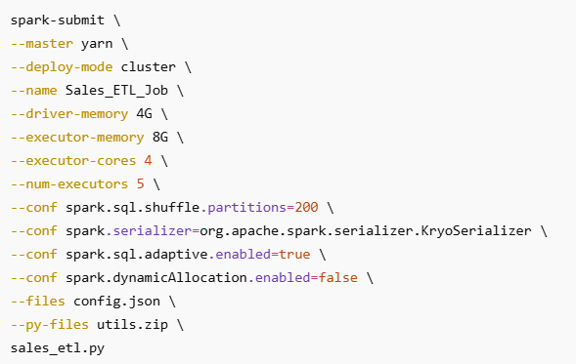
SPARK SUBMIT

Slide 5
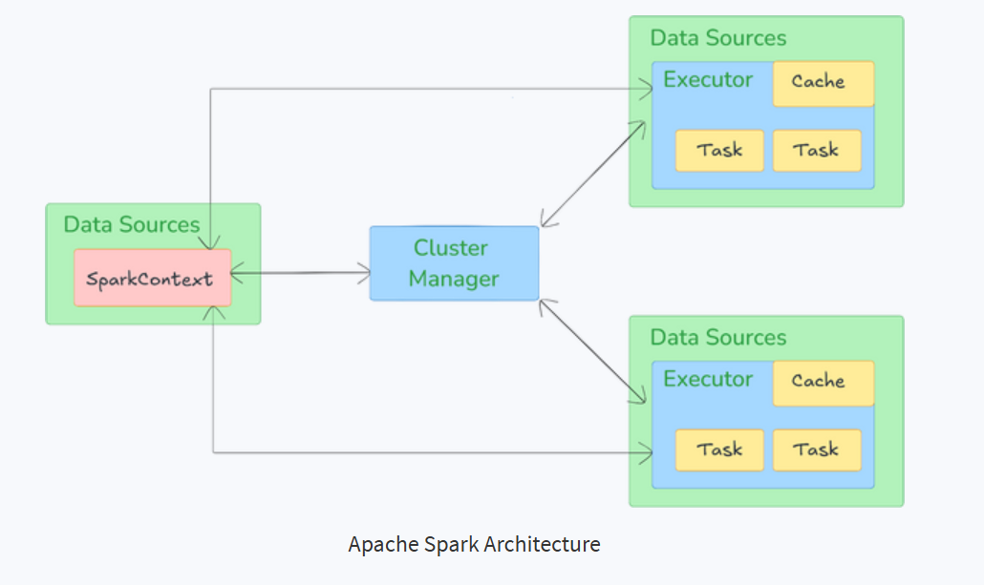
SPARK OPTIMIZATION

Slide 6
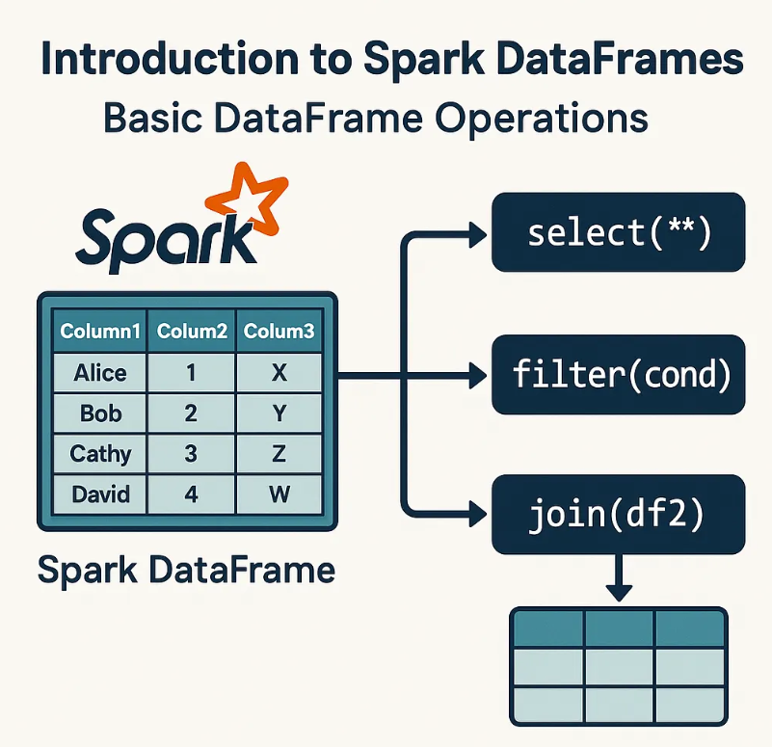
1) Use DataFrames/Datasets over RDDs

Slide 7

DataFrames

Slide 8
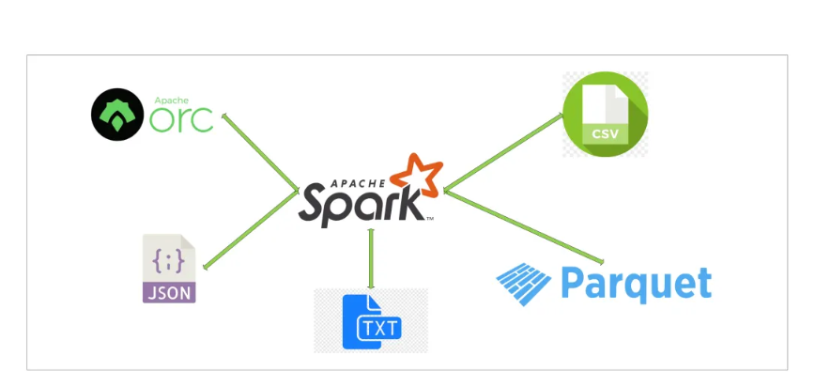
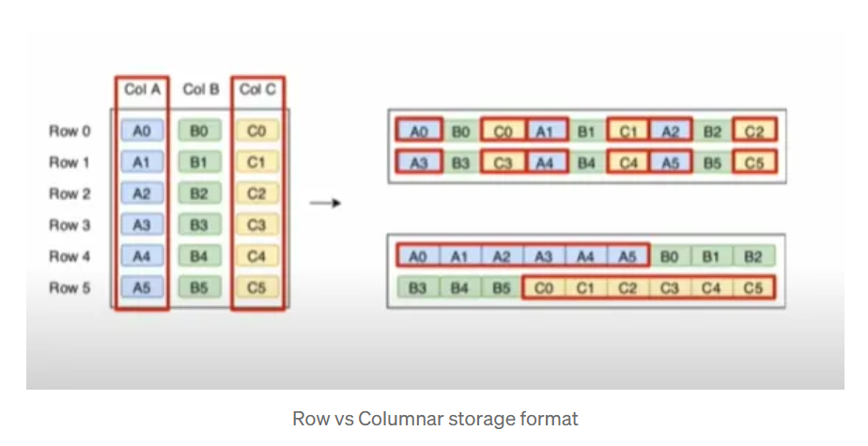
FILE FORMATS

Slide 9
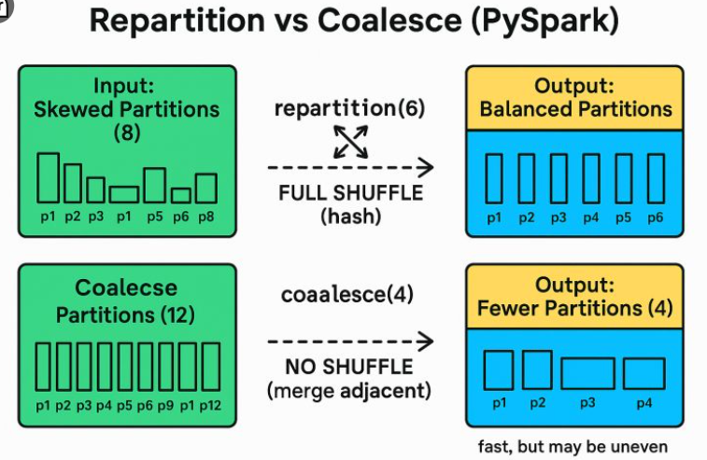
2) Optimize Data Partitioning – Repartitioning and coalesce

Slide 10
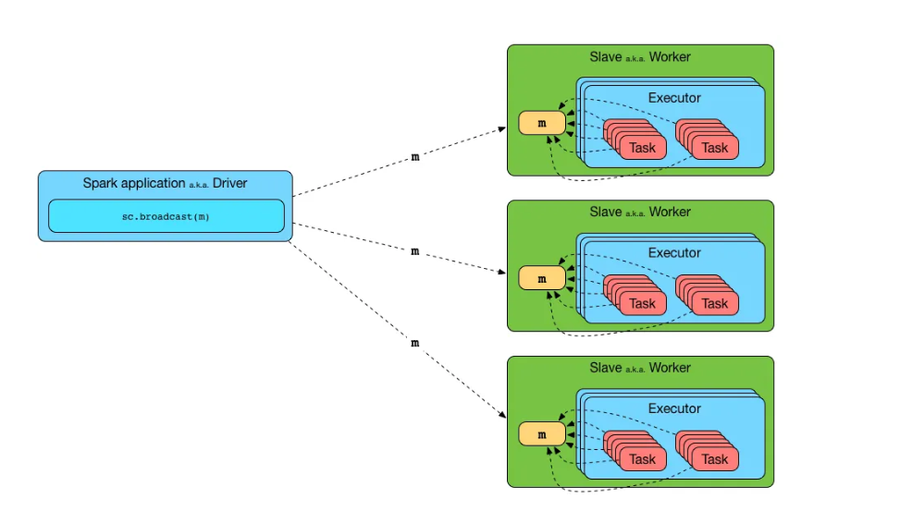
3) Minimize Shuffle Operations - Broadcasting

Slide 11
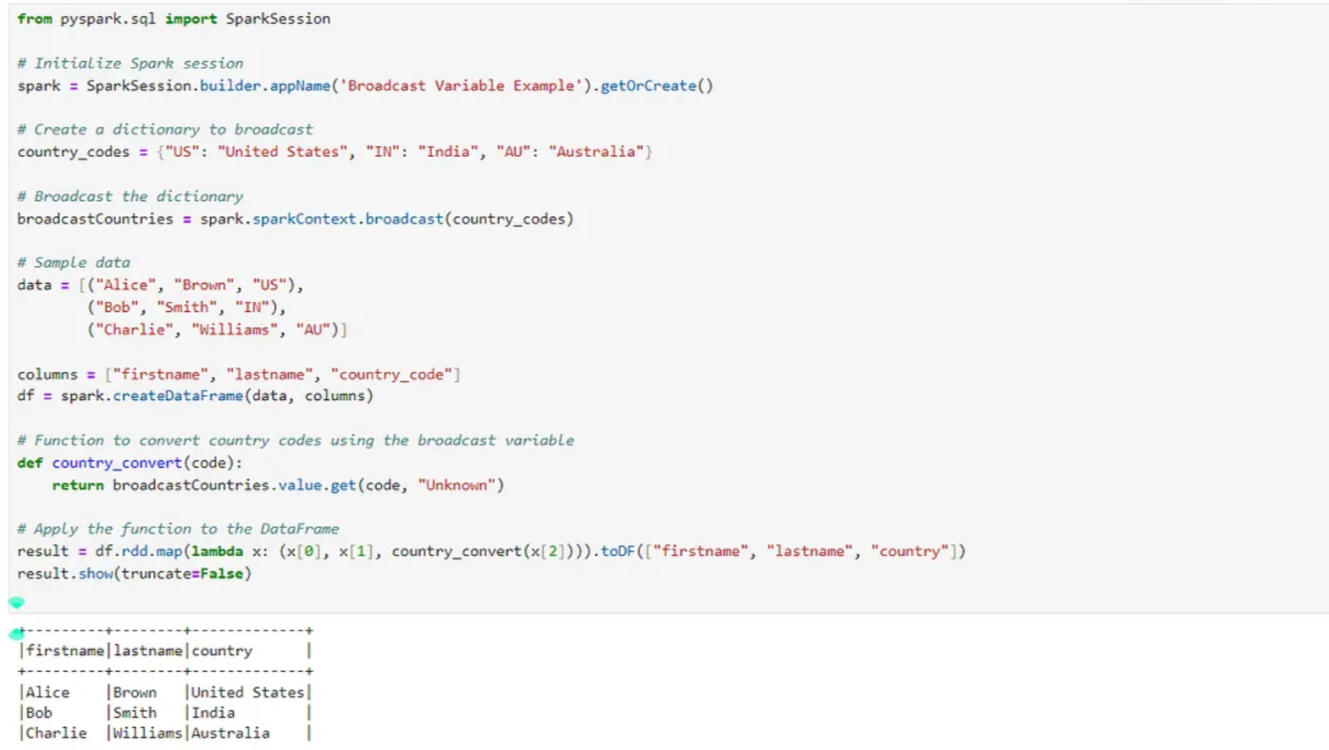

Slide 12
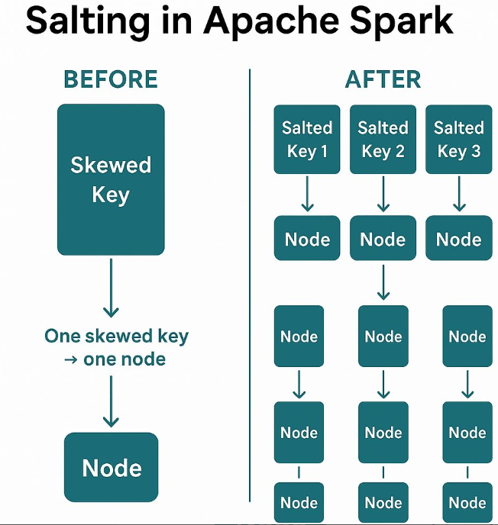
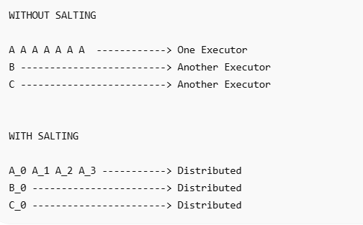
4) SALTING

Slide 13
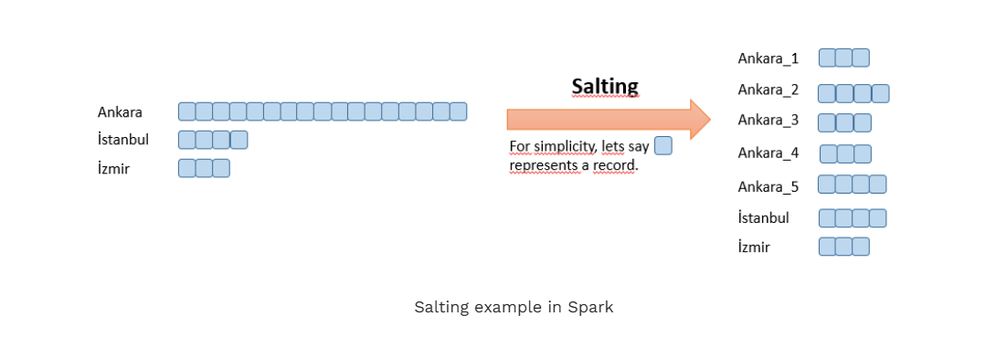

Slide 14
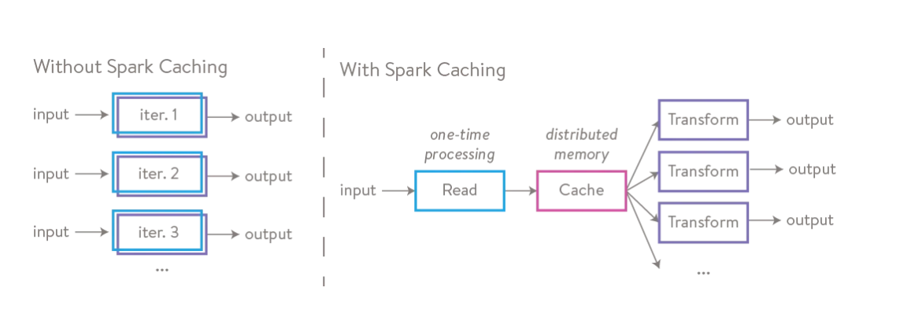
5) Implement Effective Caching and Persistence

Slide 15
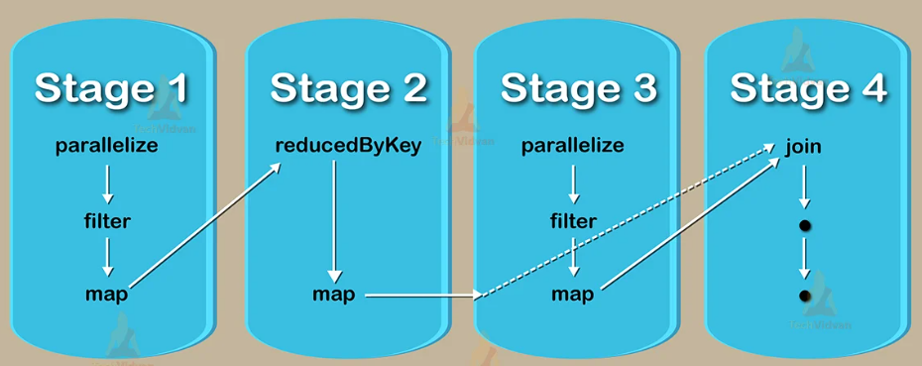
DAG –Direct Acyclic Graph

